Slide 1

“Machine learning techniques in sensor based human activity recognition and understanding human actions using still images”
Saura Elghonimi
Eduardo R
Khushboo Agarwal

Slide 2
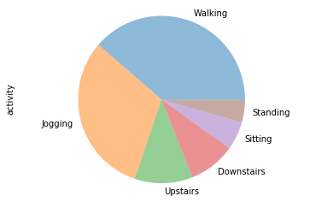
Data sources – WISDM Dataset
http://www.cis.fordham.edu/wisdm/dataset.php
Raw time series data
Number of examples
1,098,207
Number of attributes – 6
Class Distribution
Walking: 424,400 (38.6%)
Jogging: 342,177 (31.2%)
Upstairs: 122,869 (11.2%)
Downstairs: 100,427 (9.1%)
Sitting: 59,939 (5.5%)
Standing: 48,395 (4.4%)
Contains all x,y,z acceleration values
Transformed
Number of transformed examples: 5,424
Number of transformed attributes: 46(tuple)
Missing attribute values: None
Class Distribution
Walking: 2,082 (38.4%)
Jogging: 1,626 (30.0%)
Upstairs: 633 (11.7%)
Downstairs: 529 (9.8%)
Sitting: 307 (5.7%)
Standing: 247 (4.6%)
Calculations –
Statistical measures taking 10 second window(20 record every second)
Total 200 records
XAVG, YAVG, ZAVG
.XPEAK, YPEAK, ZPEAK
XABSOLDEV, YABSOLDEV, ZABSOLDEV
XSTANDDEV, YSTANDDEV, ZSTANDDEV
RESULTANT is the average of the square roots of the sum of the values of each axis squared √(xi^2 + yi^2 + zi^2).
X0,X1X2…….Z8,Z9
Fraction of acceleration that fell within the bin

Slide 3
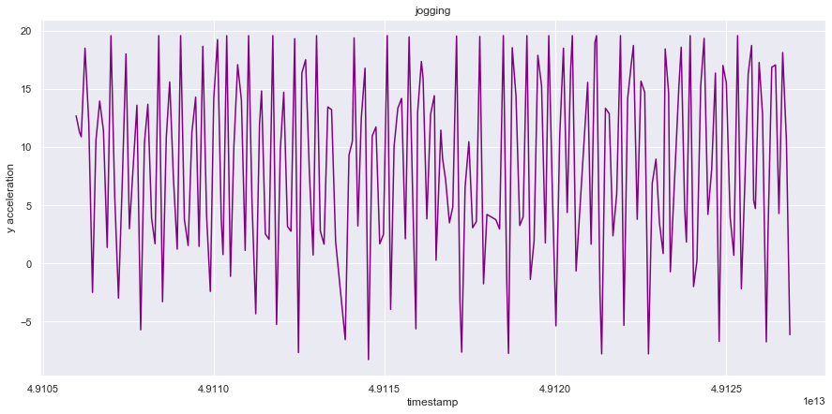
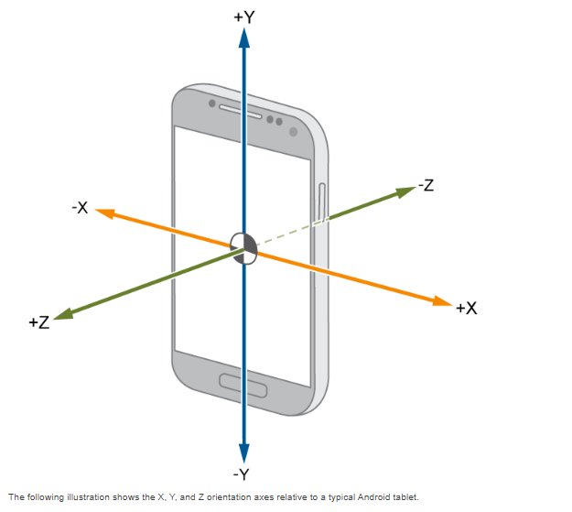
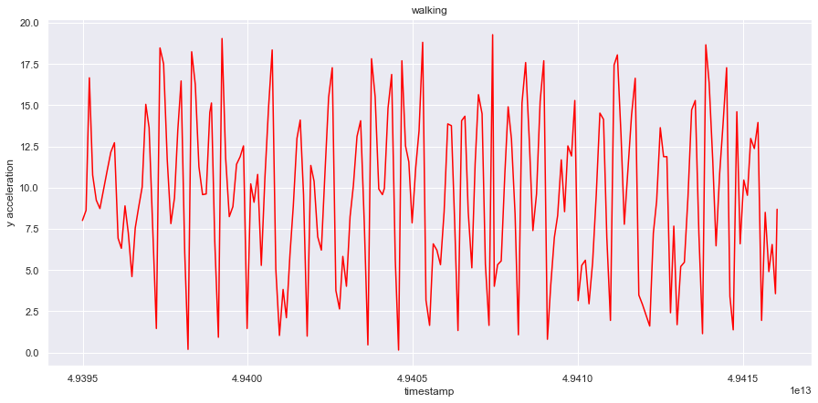
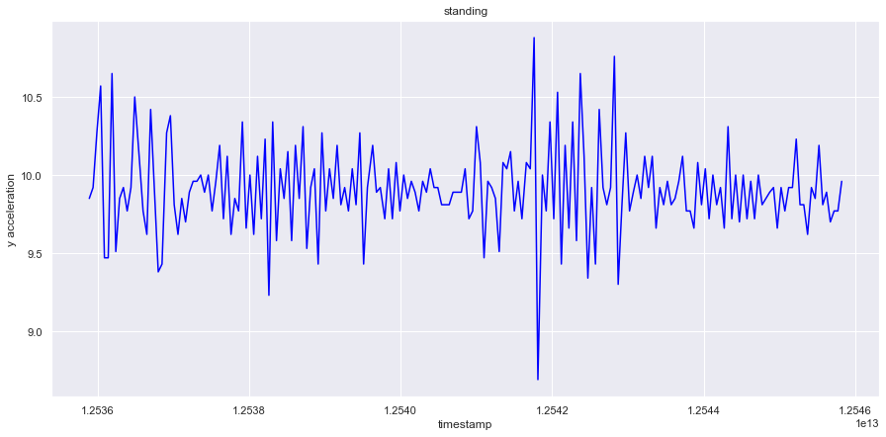
ACCELEROMETER
SOURCE -MathWorks

Slide 4

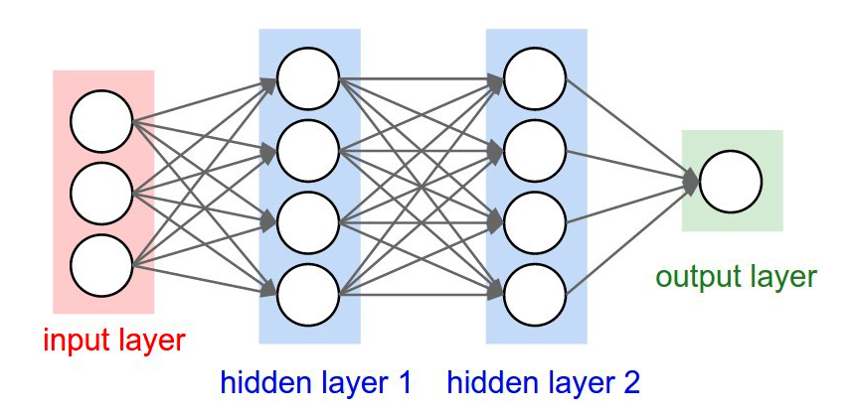
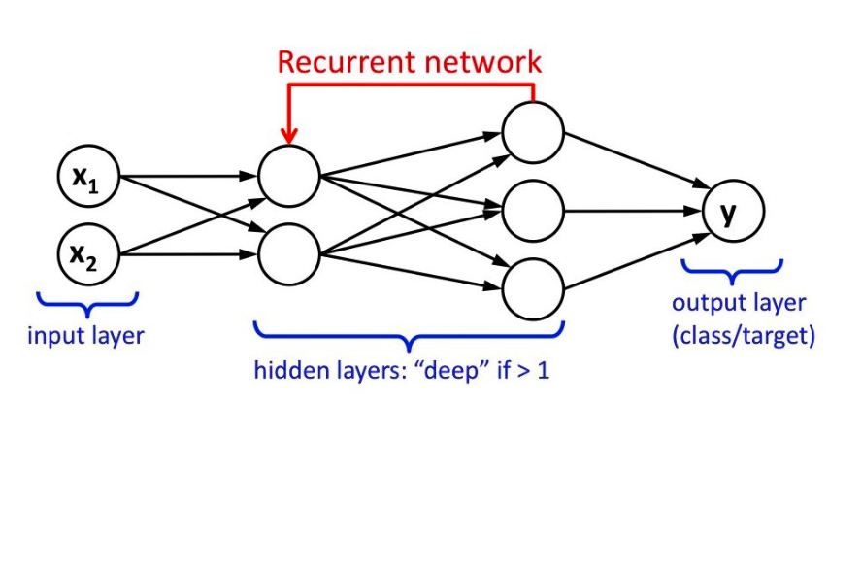
Techniques
Deep Neural Network
LSTM- Long short-term memory/Recurrent Neural Network
Deep Neural Network (DNN)
Image source-http://cs231n.github.io/neural-networks-1/
LSTM
Image source- Towards Data Science, Implementation of RNN,LSTM and GRU Chandra Churh Chatterjee

Slide 5

DEEP NEURAL NETWORK HYPERPARAMETERS RELATED TO NETWORK STRUCTURE

Slide 6

DEEP NEURAL NETWORK
Applied Deep Neural network on the reformatted data(raw data gives poor results)
Dropouts used to avoid overfitting
Compute class weights for better accuracy of each class
Activation function – SoftMax
Experiment on two models using different number of hidden layers
Optimizer - adam

Slide 7
EXPERIMENT 1 – DNN
Model 1-DNN
Input dimension = 42
Model 2 -DNN
Softmax activation layer
6 outputs
Hidden layers
Hidden layer with 100 nodes
SoftMax activation for the last layer
60 nodes
Dropout
Droput
Model 1 -Accuracy 87.4 %
Model 2 – Accuracy 82%
Input dimension -= 42
60 nodes
100 nodes
196 nodes
196 nodes
32 nodes
6 outputs

Slide 8
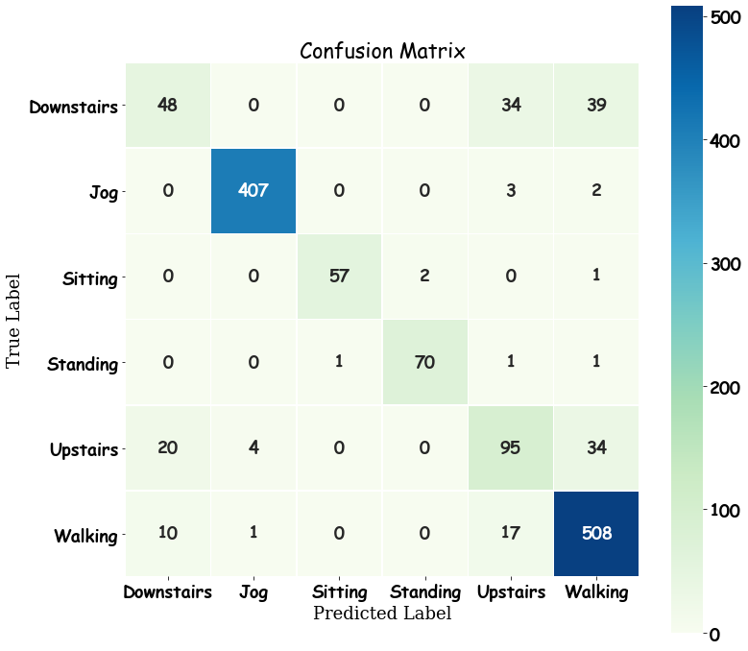
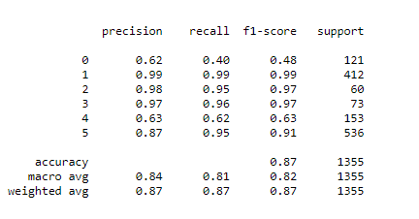

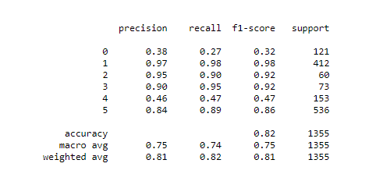
Comparison of confusion matrix
Model 1
Model 2

Slide 9

EXPERIMENT 2 LSTM MODEL
Using raw timeseries data
200 steps with Sliding window of 50 ((16692,200,3))
200 steps with Non sliding window((4173,200,3))
LSTM model does not work well on the reformatted data ,low accuracy of 67%
Dividing data into test and training based on the user id
Optimizer rms_prop

Slide 10
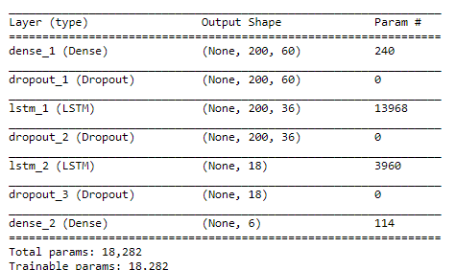
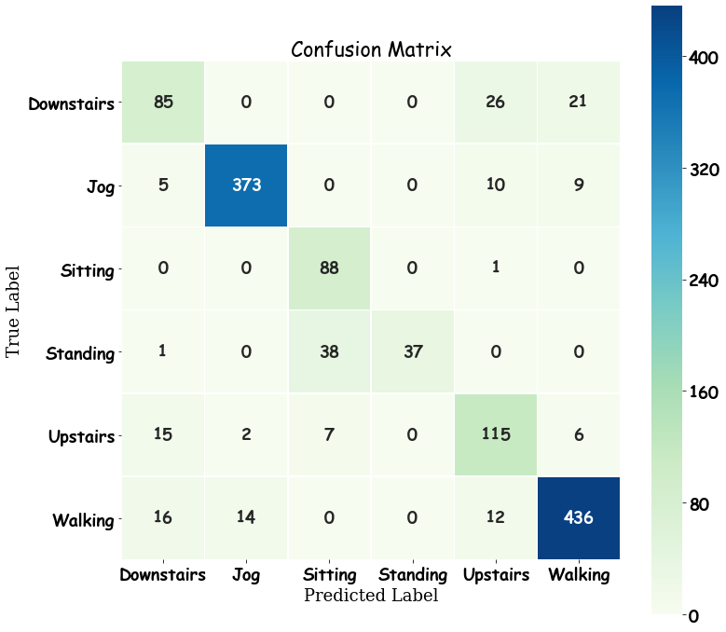
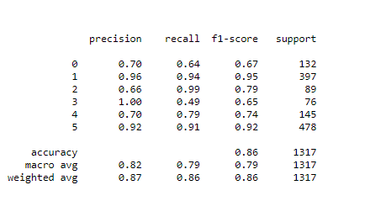
LSTM MODEL WITH SLIDING WINDOW
ACCURACY 86.1%

Slide 11

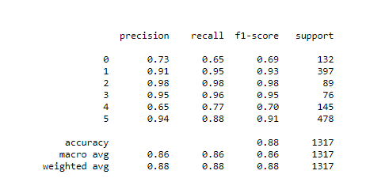
LSTM MODEL WITHOUT SLIDING WINDOW
ACCURACY – 87.7%

Slide 12

Image Classification
Image Based Human Activity Recognition

Slide 13
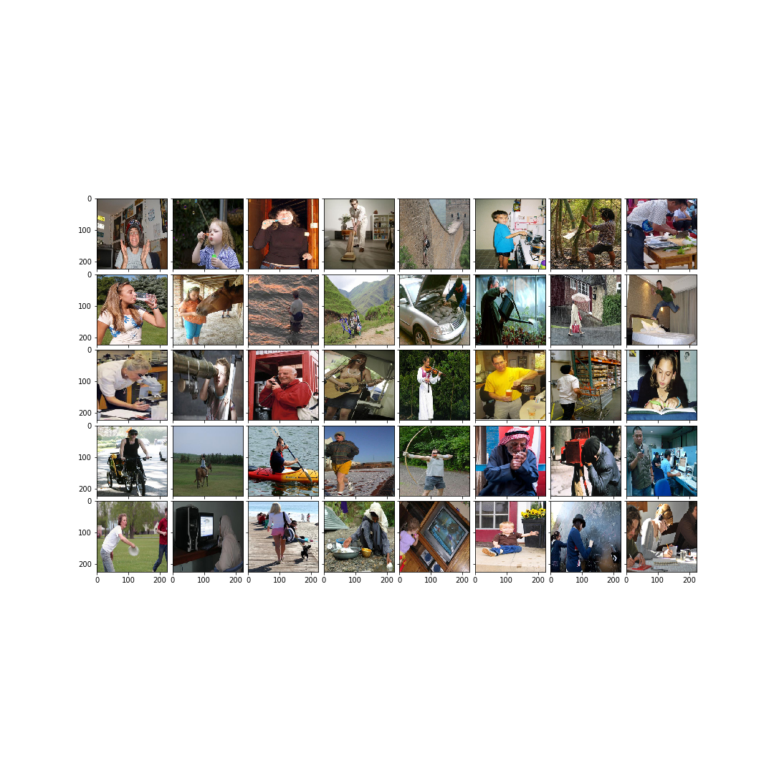
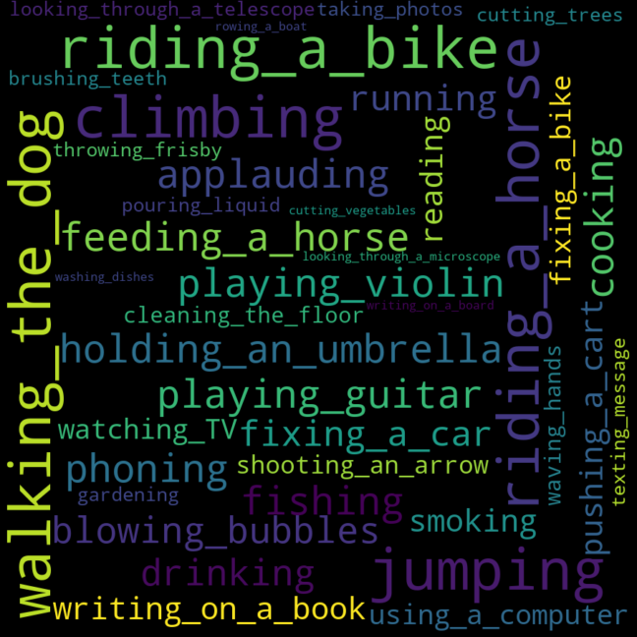
Stanford 40
A dataset for understanding human actions in still images

Slide 14
Classes
Applauding
Climbing
Cooking
Feeding a horse
Holding an umbrella
Jumping
Playing guitar
Riding a bike
Riding a horse
Walking the dog
Ten action classes with the largest number of images

Slide 15
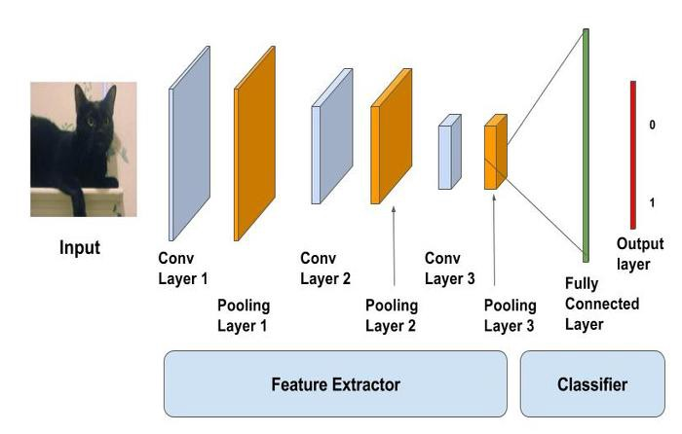
Convolution Layer
Pooling Layer
Applies filters to image
Positioned directly after convolution layer
Downsamples output of convolution layer
Dense Fully-Connected Layer
The very last/deepest layers of neural network
Maps features to class labels
Extracts features
Convolutional
Neural Networks
(CNN)
CNN

Slide 16
Transfer Learning
A machine learning strategy where a pre-trained model is used as the starting point for a new model
Some Pre-Trained Models
VGG19
MobileNet
InceptionResNetV2
ResNet50
Xception

Slide 17
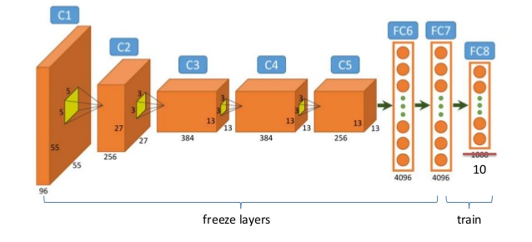
Transfer Learning
Fine Tuning
Load pre-trained model
Freeze all but the last few layers
Add your own dense fully-connected layer
Train the model with new data
New model will recognize classes that the pre-trained model could not identify

Slide 18
Fine Tuning Results
79%
Xception
77%
71%
VGG16
42%
InceptionResNetV2
MobileNet
24%
ResNet50

Slide 19
Transfer Learning
Pre-Trained Model
Inception-ResNetV2
Classifier Models
Logistic Regression
Random Forest Classification
Support Vector Machine
Feature Extraction
Object Detection
Load pre-trained model
Feed images into model to make a prediction
Extract the predicted features
Feed features vector into a new model
New model is trained on features vector, NOT original images
New model outputs class labels
Object Recognition

Slide 20
Feature Extraction Results
96%
Logistic Regression
94%
Support Vector Machine
90%
Random Forest

Slide 21

CITATIONS/REFERENCES
1.Activity Recognition using cellphone Accelerometers Jennifer R. Kwapisz, Gary M. Weiss, Samuel A. Moore 2. Human Activity Recognition(HAR) Tutorial with Keras and Core ML(Part 1) Nils Ackermann –Towards Data Science 3.The impact of Personalization of smartphone – Based Activity Recognition Gary M. Weiss and Jeffrey W. Lockhart 4.Human Activity Recognition using LSTMs on Android – TensorFlow for Hackers (Part 6) Venelin Valkov –Medium

